Slide 1
Automata – What is it?
The term "Automata" is derived from the Greek word "αὐτόματα" which means "selfacting". An automaton (Automata in plural) is an abstract self-propelled computing device which follows a predetermined sequence of operations automatically.
An automaton with a finite number of states is called a Finite Automaton (FA) or Finite State Machine (FSM).

Slide 2
Formal definition of a Finite Automaton
An automaton can be represented by a 5-tuple (Q, Σ, δ, q0, F), where:
Q is a finite set of states.
Σ is a finite set of symbols, called the alphabet of the automaton.
δ is the transition function.
q0 is the initial state from where any input is processed (q0 ∈ Q).
F is a set of final state/states of Q (F ⊆ Q).

Slide 3
Related Terminologies
Alphabet Definition: An alphabet is any finite set of symbols.
Example: Σ = {a, b, c, d} is an alphabet set where ‘a’, ‘b’, ‘c’, and ‘d’ are symbols.
String Definition: A string is a finite sequence of symbols taken from Σ.
Example: ‘cabcad’ is a valid string on the alphabet set Σ = {a, b, c, d}

Slide 4
Length of a String Definition : It is the number of symbols present in a string. (Denoted by |S|).
Examples:
If S=‘cabcad’, |S|= 6
If |S|= 0, it is called an empty string (Denoted by λ or ε)

Slide 5
Kleene Star
Definition: The Kleene star, Σ*, is a unary operator on a set of symbols or strings, Σ, that gives the infinite set of all possible strings of all possible lengths over Σ including λ.
Representation: Σ* = Σ0 U Σ1 U Σ2 U……. where Σp is the set of all possible strings of length p.
Example: If Σ = {a, b}, Σ*= {λ, a, b, aa, ab, ba, bb,………..}

Slide 6
Kleene Closure / Plus
Definition: The set Σ+ is the infinite set of all possible strings of all possible lengths over Σ excluding λ.
Representation: Σ+ = Σ1 U Σ2 U Σ3 U……. Σ+ = Σ* − { λ }
Example: If Σ = { a, b } , Σ+ ={ a, b, aa, ab, ba, bb,………..}

Slide 7
Language
Definition : A language is a subset of Σ* for some alphabet Σ. It can be finite or infinite.
Example : If the language takes all possible strings of length 2 over Σ = {a, b}, then L = { ab, bb, ba, bb}

Slide 8
2. Deterministic Finite Automaton
Finite Automaton can be classified into two types:
Deterministic Finite Automaton (DFA)
Non-deterministic Finite Automaton (NDFA / NFA)
In DFA, for each input symbol, one can determine the state to which the machine will move. Hence, it is called Deterministic Automaton. As it has a finite number of states, the machine is called Deterministic Finite Machine or Deterministic Finite Automaton.

Slide 9
Formal Definition of a DFA
A DFA can be represented by a 5-tuple (Q, Σ, δ, q0, F) where:
Q is a finite set of states.
Σ is a finite set of symbols called the alphabet.
δ is the transition function where δ: Q × Σ → Q
q0 is the initial state from where any input is processed (q0 ∈ Q).
F is a set of final state/states of Q (F ⊆ Q).

Slide 10
Graphical Representation of a DFA
A DFA is represented by digraphs called state diagram.
The vertices represent the states.
The arcs labeled with an input alphabet show the transitions.
The initial state is denoted by an empty single incoming arc.
The final state is indicated by double circles.

Slide 11
Example : Let a deterministic finite automaton be
Q = {a, b, c},
Σ = {0, 1},
q0={a},
F={c}, and

Slide 12
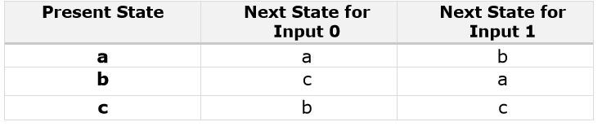
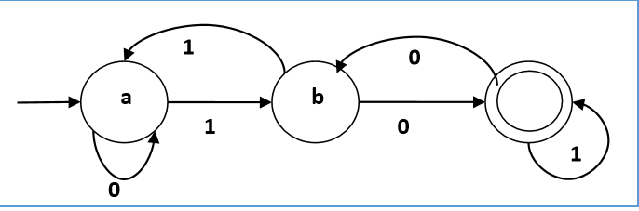
Transition function δ as shown by the following table:
Its graphical representation would be as follows:
c

Slide 13
Non-deterministic Finite Automaton
In NDFA, for a particular input symbol, the machine can move to any combination of the states in the machine and the exact state to which the machine moves cannot be determined. Hence, it is called Non-deterministic Automaton. As it has finite number of states, the machine is called Non-deterministic Finite Machine or Nondeterministic Finite Automaton.

Slide 14
Formal Definition of an NDFA
An NDFA can be represented by a 5-tuple (Q, Σ, δ, q0, F) where:
Q is a finite set of states.
Σ is a finite set of symbols called the alphabets.
δ is the transition function where δ: Q × Σ → 2^{Q} (Here the power set of Q (2^{Q}) has been taken because in case of NDFA, from a state, transition can occur to any combination of Q states)
q0 is the initial state from where any input is processed (q0 ∈ Q).
F is a set of final state/states of Q (F ⊆ Q).

Slide 15
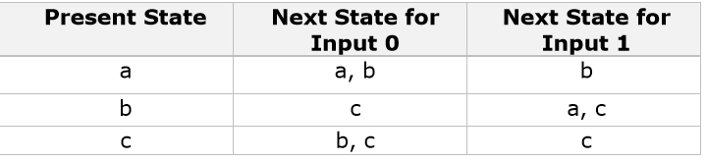
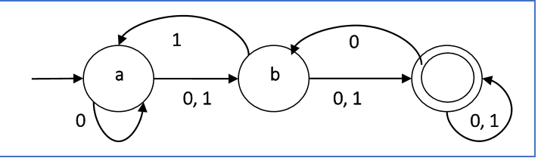
Example :
Let a non-deterministic finite automaton be Q = {a, b, c} , Σ = {0, 1} ,q0 = {a} ,F={c}
The transition function δ as shown below:
Its graphical representation would be as follows:
c

Slide 16
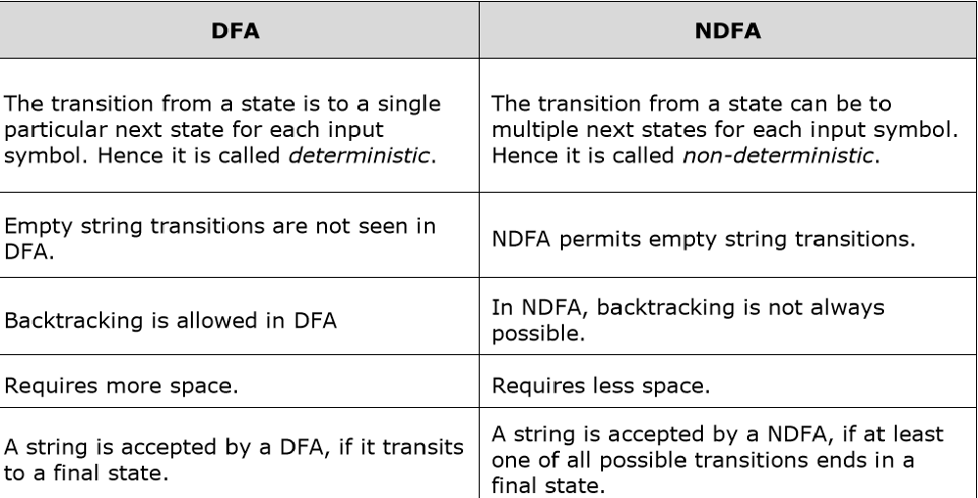
DFA vs NDFA

Slide 17
Acceptors, Classifiers, and Transducers
Acceptor (Recognizer): An automaton that computes a Boolean function is called an acceptor. All the states of an acceptor is either accepting or rejecting the inputs given to it.
Classifier : A classifier has more than two final states and it gives a single output when it terminates.
Transducer: An automaton that produces outputs based on current input and/or previous state is called a transducer. Transducers can be of two types:
Mealy Machine : The output depends both on the current state and the current input.
Moore Machine: The output depends only on the current state.

Slide 18
Acceptability by DFA and NDFA
A string is accepted by a DFA/NDFA iff the DFA/NDFA starting at the initial state ends in an accepting state (any of the final states) after reading the string wholly.
A string S is accepted by a DFA/NDFA (Q, Σ, δ, q0, F), iff
δ*(q0, S) ∈ F
The language L accepted by DFA/NDFA is
{S | S ∈ Σ* and δ*(q0, S) ∈ F}
A string S′ is not accepted by a DFA/NDFA (Q, Σ, δ, q0, F), iff
δ*(q0, S′) ∉ F
The language L′ not accepted by DFA/NDFA (Complement of accepted language L) is
{S | S ∈ Σ* and δ*(q0, S) ∉ F}

Slide 19
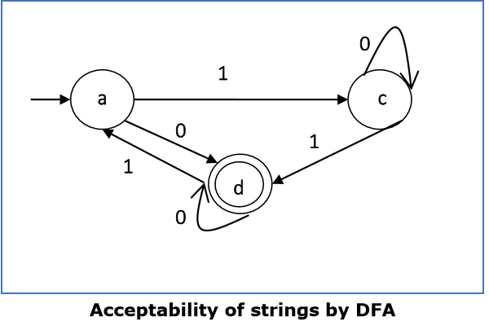
Example:
Strings accepted by the above DFA: {0, 00, 11, 010, 101, ...........}
Strings not accepted by the above DFA: {1, 011, 111, ........}

Slide 20
NDFA to DFA Conversion
Problem Statement Let X = (Qx, Σ, δx, q0, Fx) be an NDFA which accepts the language L(X). We have to design an equivalent DFA Y = (Qy, Σ, δy, q0, Fy) such that L(Y) = L(X). The following procedure converts the NDFA to its equivalent DFA:
Algorithm Input: An NDFA
Output: An equivalent DFA
Step 1: Create state table from the given NDFA.
Step 2: Create a blank state table under possible input alphabets for the equivalent DFA.
Step 3: Mark the start state of the DFA by q0 (Same as the NDFA).
Step 4 :Find out the combination of States {Q0, Q1,... , Qn} for each possible input alphabet.
Step 5: Each time we generate a new DFA state under the input alphabet columns, we have to apply step 4 again, otherwise go to step 6.
Step 6 : The states which contain any of the final states of the NDFA are the final states of the equivalent DFA.

Slide 21
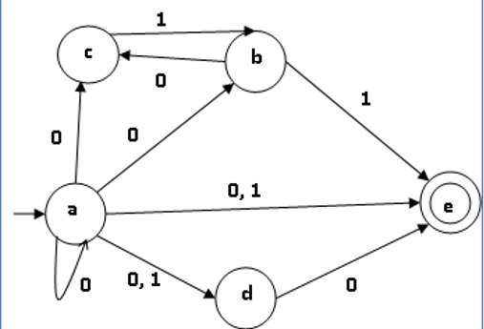
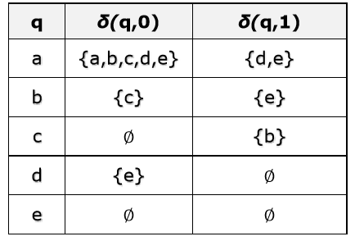
Example
Let us consider the NDFA shown in the figure below:

Slide 22
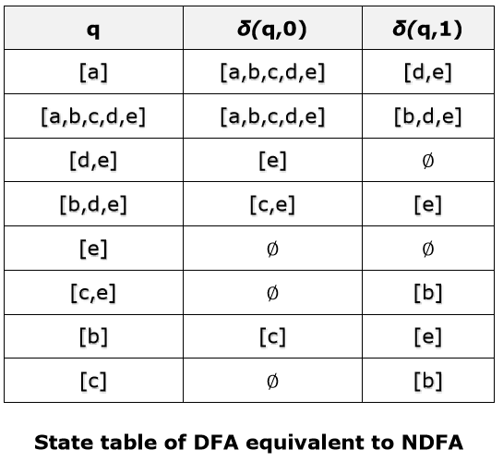
Using the above algorithm, we find its equivalent DFA. The state table of the DFA is shown in below:

Slide 23
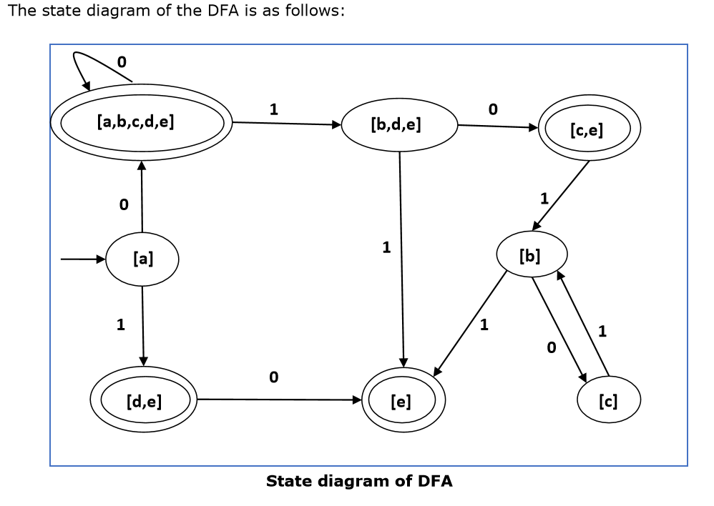

Slide 24
DFA Minimization
DFA Minimization using Myphill-Nerode Theorem:
Algorithm: Input DFA
Output : Minimized DFA
Step 1: Draw a table for all pairs of states (Qi, Qj) not necessarily connected directly [All are unmarked initially]
Step 2: Consider every state pair (Qi, Qj) in the DFA where Qi ∈ F and Qj ∉ F or vice versa and mark them. [Here F is the set of final states]
Step 3 : Repeat this step until we cannot mark anymore states:
If there is an unmarked pair (Qi, Qj), mark it if the pair {δ(Qi, A), δ (Qi, A)} is marked for some input alphabet.
Step 4: Combine all the unmarked pair (Qi, Qj) and make them a single state in the reduced DFA

Slide 25
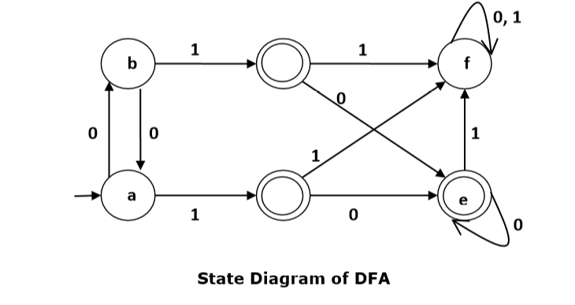
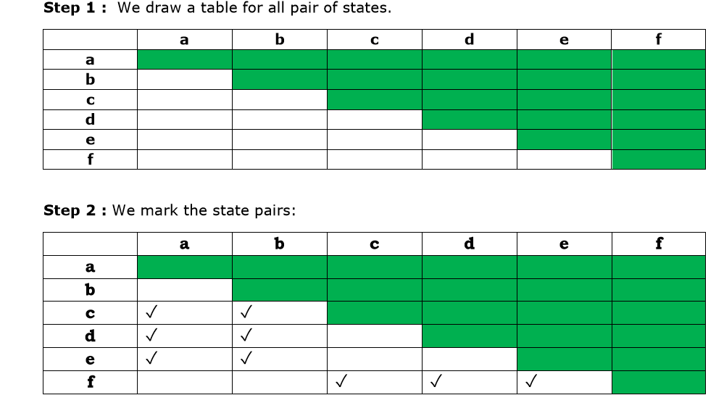
Let us use Algorithm 2 to minimize the DFA shown below.
d
c

Slide 26
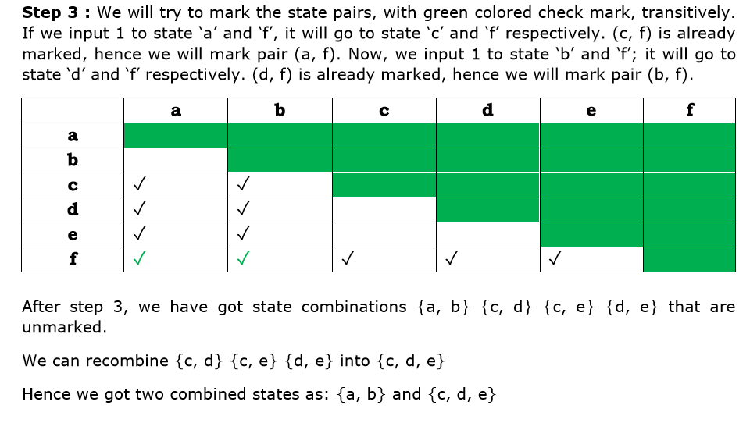

Slide 27
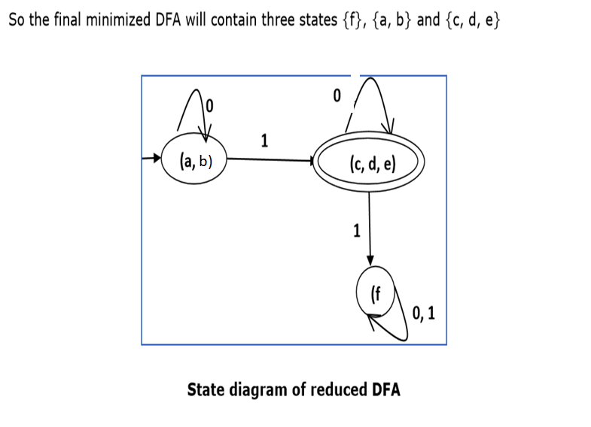

Slide 28
DFA Minimization using Equivalence Theorem
If X and Y are two states in a DFA, we can combine these two states into {X, Y} if they are not distinguishable. Two states are distinguishable, if there is at least one string S, such that one of δ (X, S) and δ (Y, S) is accepting and another is not accepting. Hence, a DFA is minimal if and only if all the states are distinguishable.
Algorithm 3:
Step 1: All the states Q are divided in two partitions: final states and non-final states and are denoted by P0. All the states in a partition are 0th equivalent. Take a counter k and initialize it with 0.

Slide 29
Step 2: Increment k by 1. For each partition in Pk, divide the states in Pk into two partitions if they are k-distinguishable. Two states within this partition X and Y are k-distinguishable if there is an input S such that δ(X, S) and δ(Y, S) are (k-1)-distinguishable.
Step 3: If Pk ≠ Pk-1, repeat Step 2, otherwise go to Step 4.
Step 4: Combine kth equivalent sets and make them the new states of the reduced DFA.

Slide 30
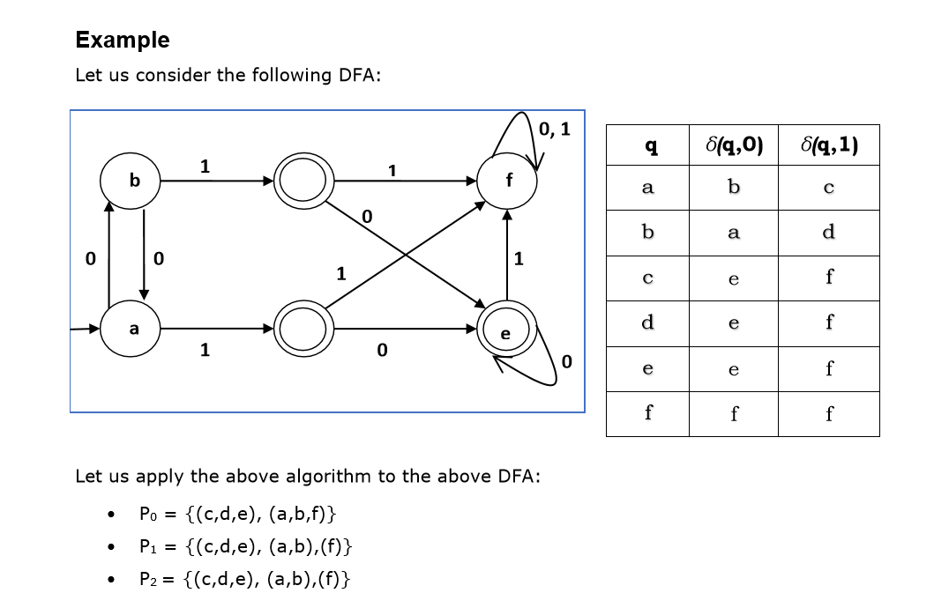
Hence, P1 = P2.
Hence, P1 = P2.
Hence, P1 = P2.
Hence, P1 = P2.
d
c

Slide 31
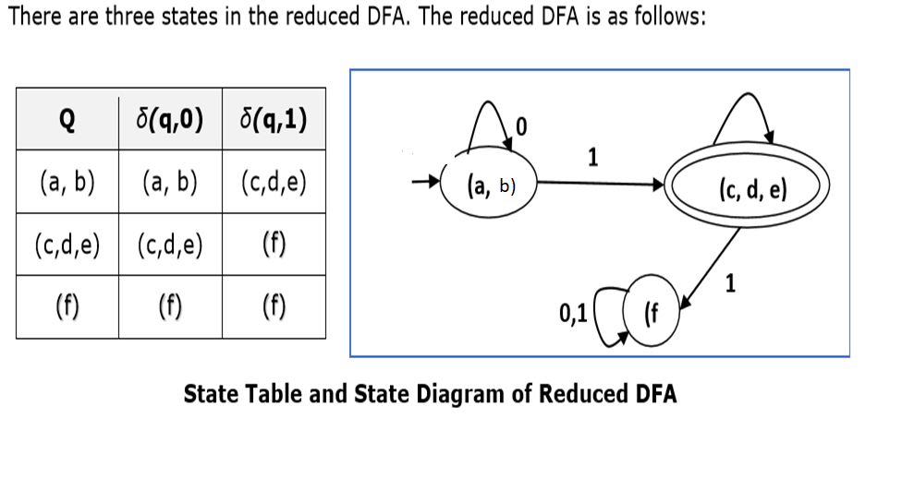
b)

Slide 32
Moore and Mealy Machines
Finite automata may have outputs corresponding to each transition. There are two types of finite state machines that generate output:
1.Mealy Machine 2. Moore machine
Mealy Machine: A Mealy Machine is an FSM whose output depends on the present state as well as the present input.
It can be described by a 6 tuple (Q, ∑, O, δ, X, q0) where −
Q is a finite set of states.
∑ is a finite set of symbols called the input alphabet.
O is a finite set of symbols called the output alphabet.
δ is the input transition function where δ: Q × Σ → Q
X is the output transition function where X: Q × Σ → O
q0 is the initial state from where any input is processed (q0 ∈ Q).

Slide 33
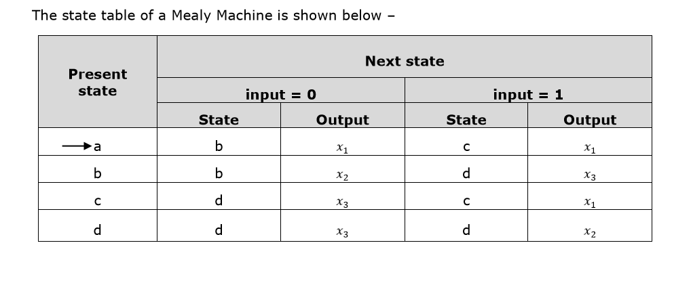
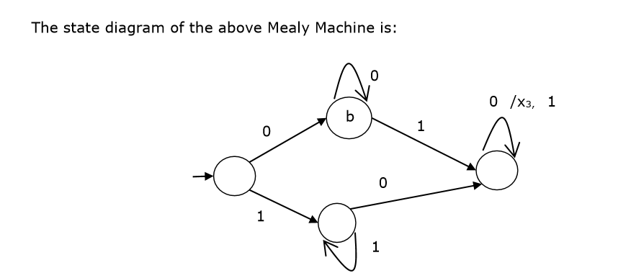
x2
x2
x1
x3
d
a
d
a
c
x3
x1
c
x1

Slide 34
Moore Machine: Moore machine is an FSM whose outputs depend on only the present state.
A Moore machine can be described by a 6 tuple (Q, Σ, O, δ, X, q0) where:
Q is a finite set of states.
Σ is a finite set of symbols called the input alphabet.
O is a finite set of symbols called the output alphabet.
δ is the input transition function where δ: Q × Σ → Q
X is the output transition function where X: Q → O
q0 is the initial state from where any input is processed (q0 ∈ Q).

Slide 35
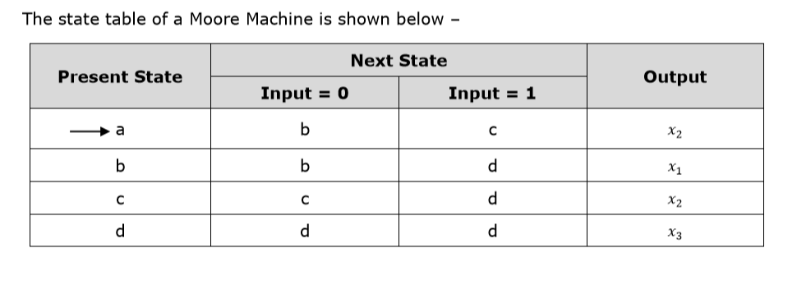
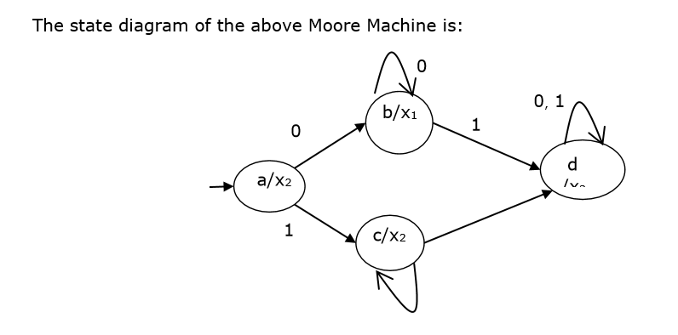
1
0

Slide 36
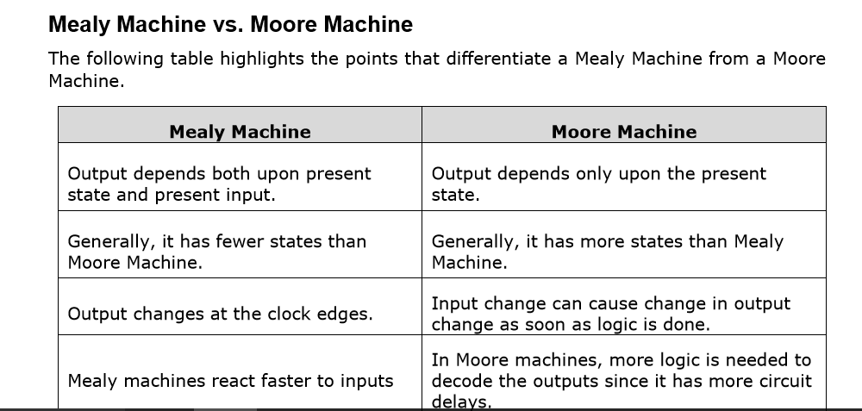

Slide 37
Moore Machine to Mealy Machine
Input: Moore Machine
Output: Mealy Machine
Step 1 Take a blank Mealy Machine transition table format.
Step 2 Copy all the Moore Machine transition states into this table format.
Step 3 Check the present states and their corresponding outputs in the Moore Machine state table; if for a state Qi output is m, copy it into table
The output columns of the Mealy Machine state table wherever Qi appears in the next state.

Slide 38
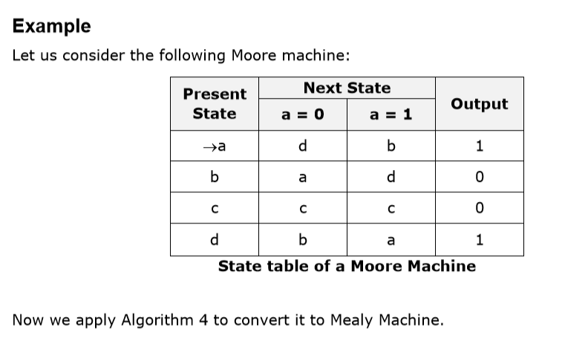

Slide 39
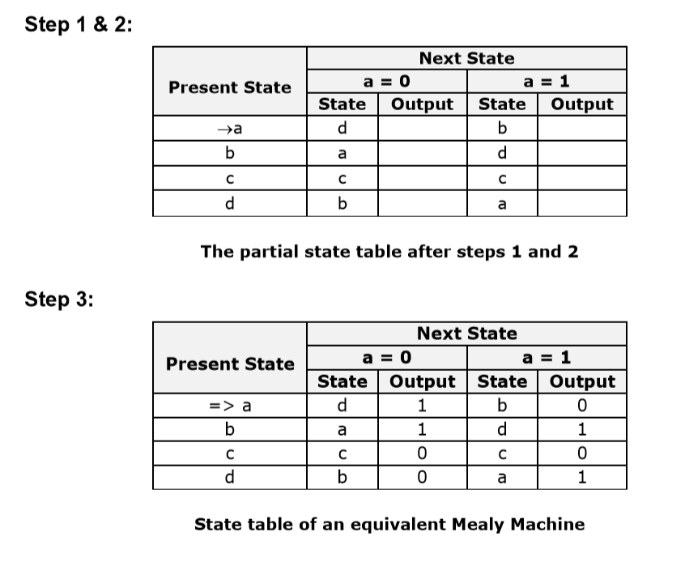

Slide 40
Mealy Machine to Moore Machine
Input: Mealy Machine
Output: Moore Machine
Step 1 Calculate the number of different outputs for each state (Qi) that are available in the state table of the Mealy machine.
Step 2 If all the outputs of Qi are same, copy state Qi. If it has n distinct outputs, break Qi into n states as Qin where n = 0, 1, 2.......
Step 3 If the output of the initial state is 1, insert a new initial state at the beginning which gives 0 output.

Slide 41
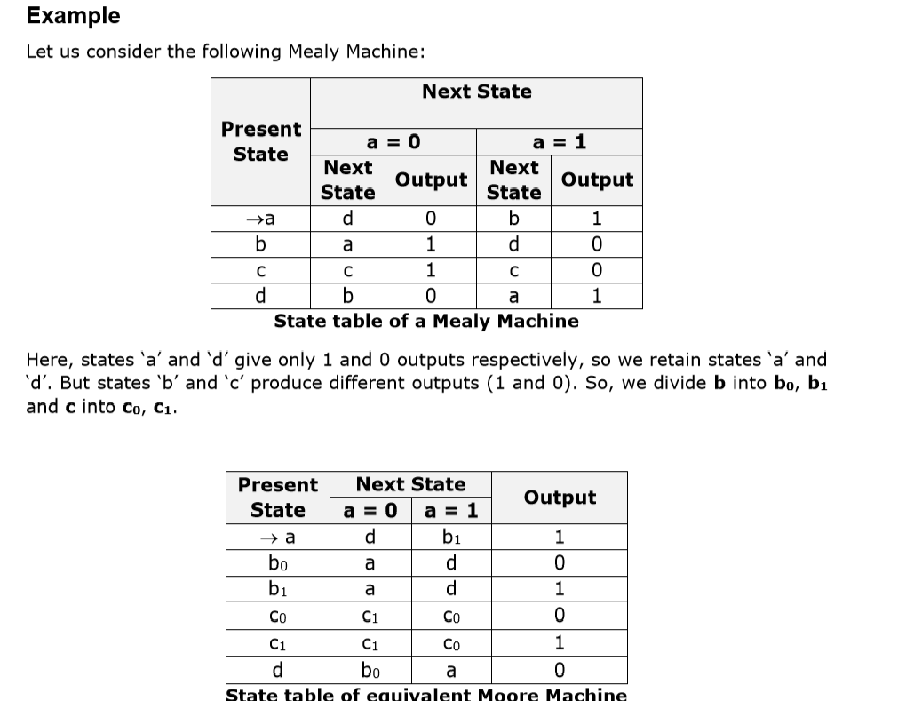

Slide 42
Grammar
A grammar G can be formally written as a 4-tuple (N, T, S, P) where
N or V_{N} is a set of variables or non-terminal symbols
T or V_{T} is a set of Terminal symbols
S is a special variable called the Start symbol, S ∈ N
P is Production rules for Terminals and Non-terminals. A production rule has the form 𝛼 → 𝛽, where 𝛼 and 𝛽 are strings on V_{N} ∪ Σ and least one symbol of 𝛼 belongs to V_{N.}

Slide 43
Example Grammar G1:
({S, A, B}, {a, b}, S, {S →AB, A →a, B →b})
S, A, and B are Non-terminal symbols;
a and b are Terminal symbols
S is the Start symbol, S ∈ N
Productions, P : S →AB, A →a, B →b
Example: Grammar G2:
({S, A}, {a, b}, S,{S → aAb, aA →aaAb, A→ε } )
Here,
S and A are Non-terminal symbols.
a and b are Terminal symbols.
ε is an empty string.
S is the Start symbol, S ∈ N
Production P : S → aAb, aA →aaAb, A→ε

Slide 44
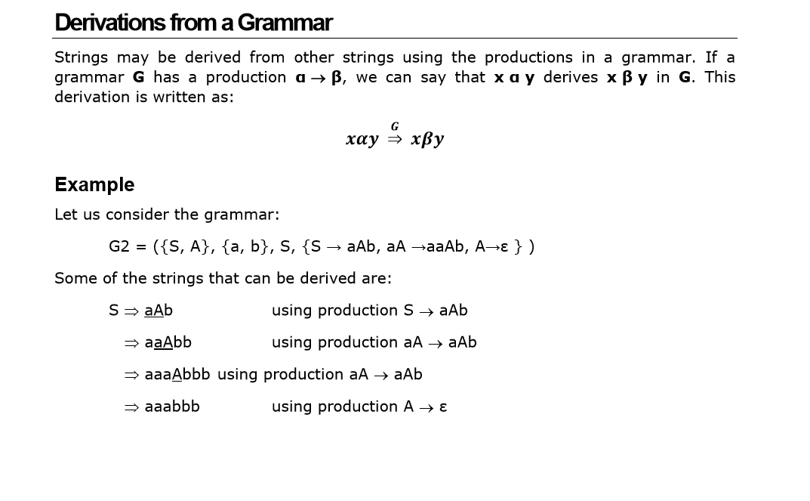

Slide 45
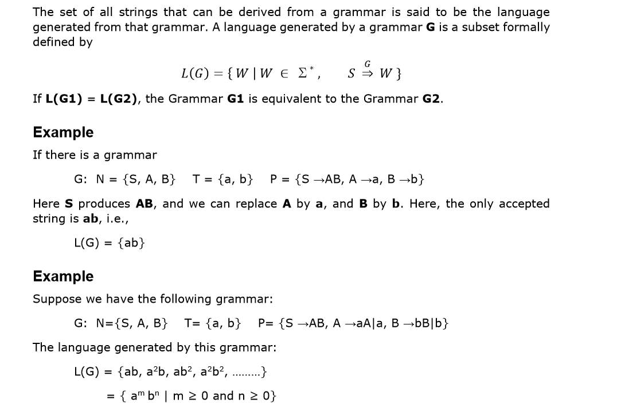
Language generated by a grammar

Slide 46
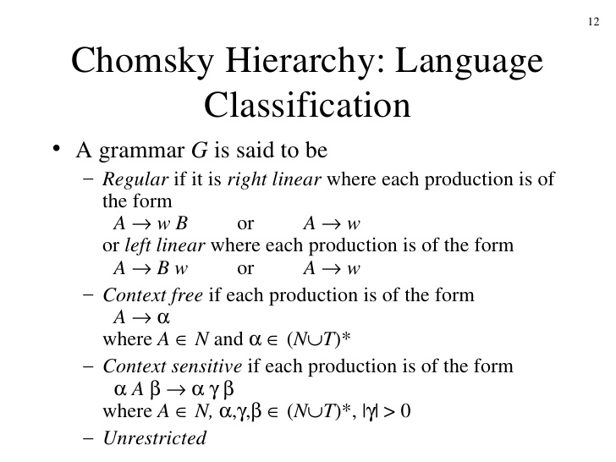

Slide 47
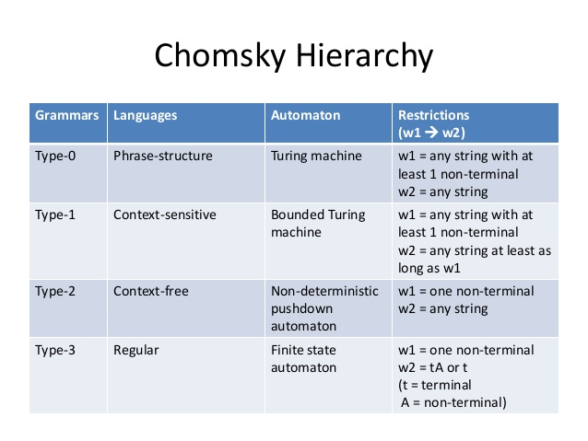

Slide 48
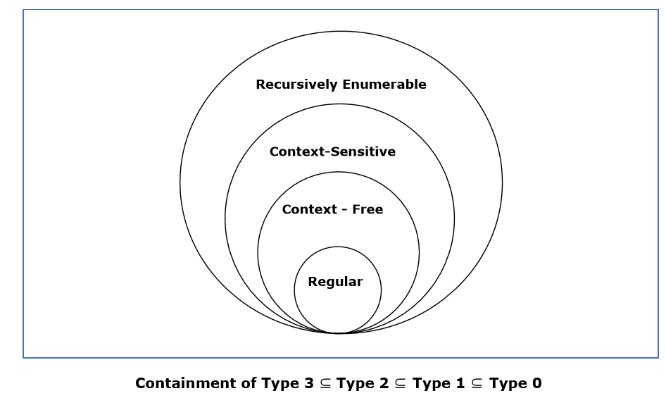

Slide 49
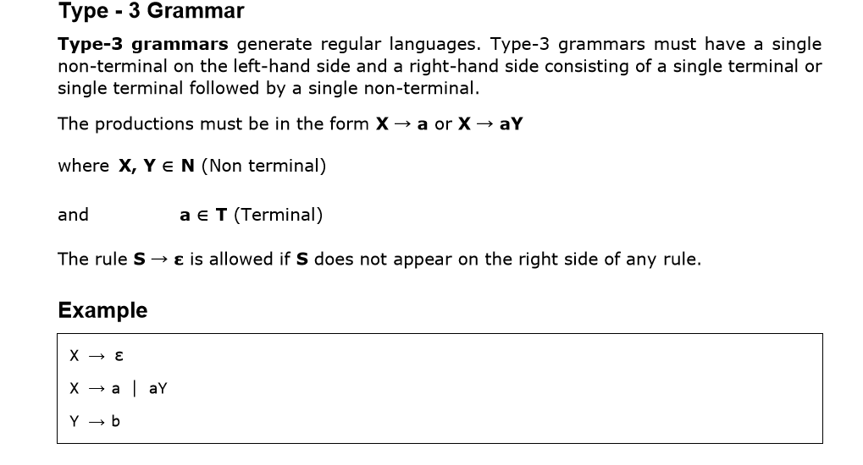

Slide 50
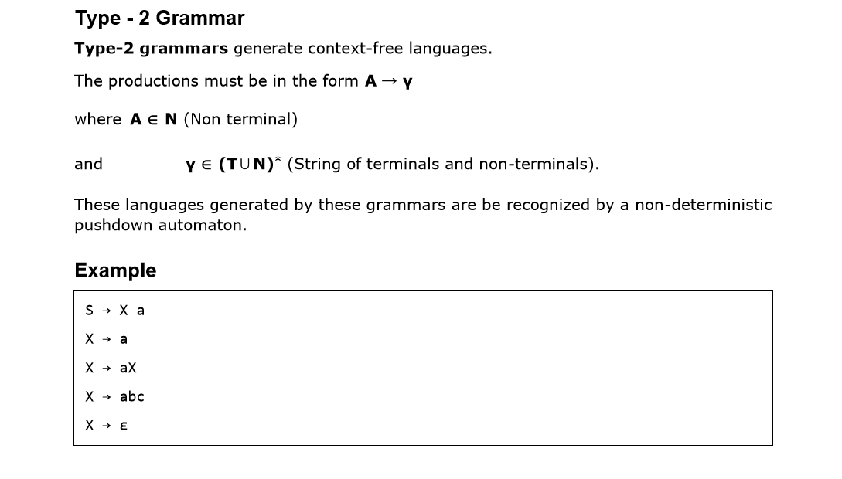

Slide 51
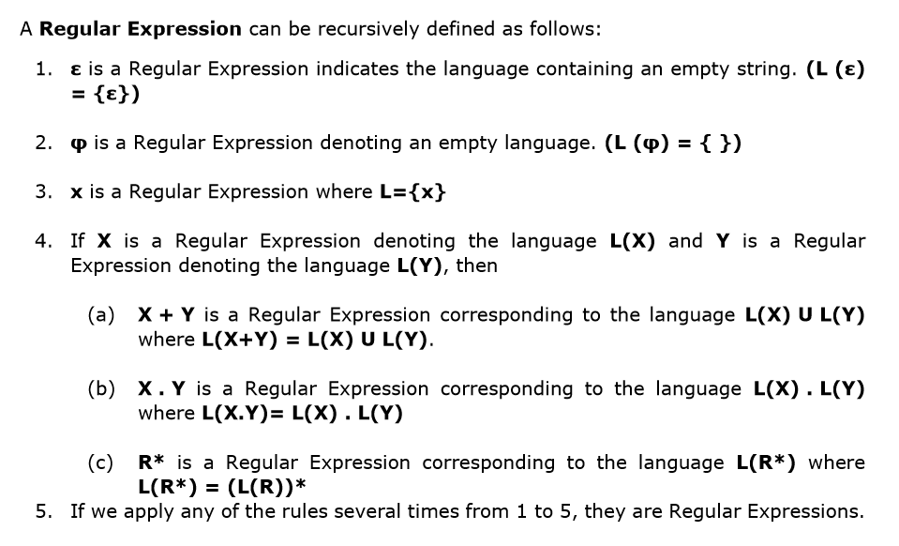
Regular Expression

Slide 52
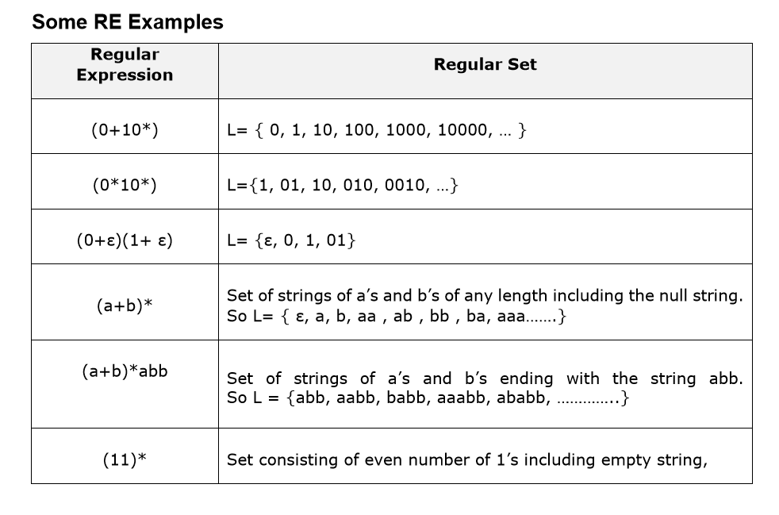

Slide 53
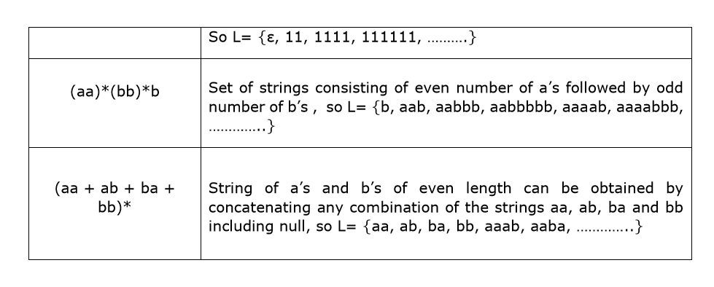

Slide 54
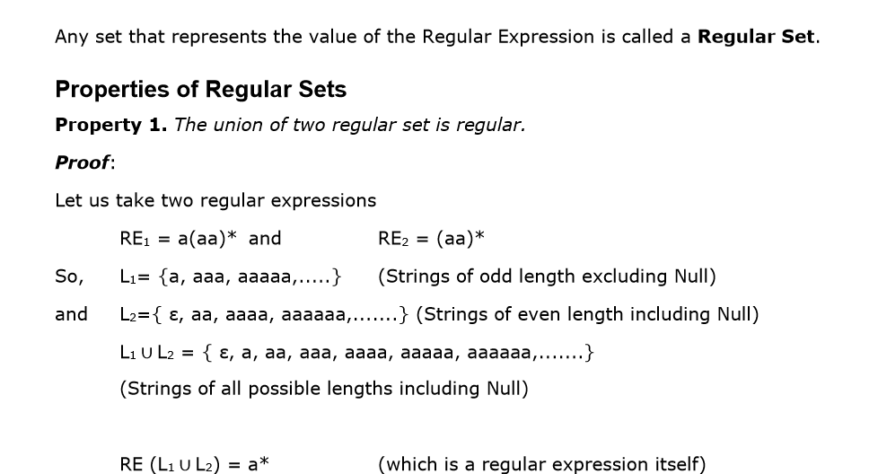
Regular Set

Slide 55
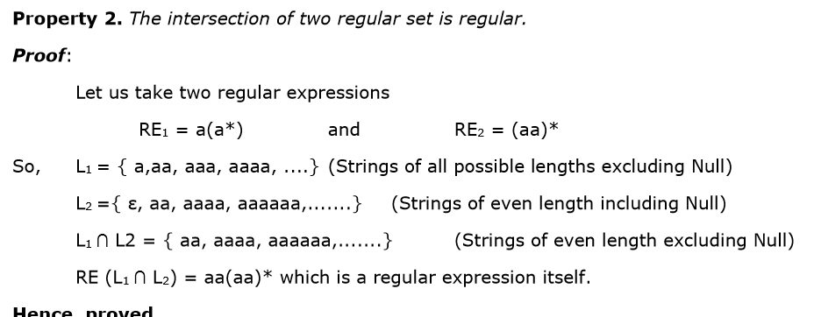

Slide 56
Property 3. The complement of a regular set is regular.
Proof: Let us take a regular expression:
RE = (aa)*
So, L = {ε, aa, aaaa, aaaaaa, .......} (Strings of even length including Null)
Complement of L is all the strings that is not in L.
So, L’ = {a, aaa, aaaaa, .....} (Strings of odd length excluding Null)
RE (L’) = a(aa)* which is a regular expression itself.
Hence, proved.

Slide 57
Property 4. The difference of two regular set is regular.
Proof:
Let us take two regular expressions:
RE1 = a (a*) and RE2 = (aa)*
So, L1= {a,aa, aaa, aaaa, ....} (Strings of all possible lengths excluding Null)
L2 = { ε, aa, aaaa, aaaaaa,.......} (Strings of even length including Null)
L1 – L2 = {a, aaa, aaaaa, aaaaaaa, ....}
(Strings of all odd lengths excluding Null)
RE (L1 – L2) = a (aa)* which is a regular expression.
Hence, proved.

Slide 58
Property 5. The reversal of a regular set is regular.
Proof:
We have to prove L^{R} is also regular if L is a regular set.
Let, L= {01, 10, 11, 10}
RE (L)= 01 + 10 + 11 + 10
L^{R} = {10, 01, 11, 01}
RE (L^{R})= 01+ 10+ 11+10 which is regular
Hence, proved.
Property 6. The closure of a regular set is regular.
Proof:
If L = {a, aaa, aaaaa, .......} (Strings of odd length excluding Null)
i.e., RE (L) = a (aa)*
L*= {a, aa, aaa, aaaa , aaaaa,……………} (Strings of all lengths excluding Null)
RE (L*) = a (a)*
Hence, proved.

Slide 59
Property 7. The concatenation of two regular sets is regular.
Proof:
Let RE1 = (0+1)*0 and RE2 = 01(0+1)*
Here, L1 = {0, 00, 10, 000, 010, ......} (Set of strings ending in 0)
and L2 = {01, 010,011,.....} (Set of strings beginning with 01)
Then, L1 L2 = {001,0010,0011,0001,00010,00011,1001,10010,.............}
Set of strings containing 001 as a substring which can be represented by an RE: (0+1)*001(0+1)* Hence, proved

Slide 60
Identities Related to Regular Expressions
Given R, P, L, Q as regular expressions, the following identities hold:
1. Ø* = ε
2. ε* = ε
3. RR* = R*R
4. R*R* = R*
5. (R*)* = R*
6. RR* = R*R
7. (PQ)*P =P(QP)*
8. (a+b)* = (a*b*)* = (a*+b*)* = (a+b*)* = a*(ba*)*
9. R + Ø = Ø + R = R (The identity for union)
10. Rε = εR = R (The identity for concatenation)

Slide 61
11. ØL = LØ = Ø (The annihilator for concatenation)
12. R + R = R (Idempotent law)
13. L (M + N) = LM + LN (Left distributive law) 14. (M + N) L = LM + LN (Right distributive law)
15. ε + RR* = ε + R*R = R*

Slide 62
Arden’s Theorem
In order to find out a regular expression of a Finite Automaton, we use Arden’s Theorem along with the properties of regular expressions.
Statement: Let P and Q be two regular expressions.
If P does not contain null string, then R = Q + RP has a unique solution that is R = QP*
Proof:
R = Q + (Q + RP)P [After putting the value R = Q + RP]
= Q + QP + RPP
When we put the value of R recursively again and again, we get the following equation:
R = Q + QP + QP2 + QP3…..
R = Q (є + P + P2 + P3 + …. )
R = QP* [As P* represents (є + P + P2 + P3 + ….) ]
Hence, proved.

Slide 63
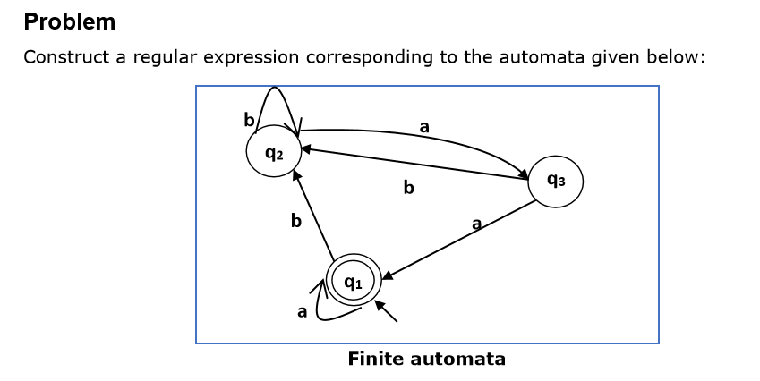

Slide 64
Solution
Here the initial state and the final state is q1.
The equations for the three states q1, q2, and q3 are as follows:
q1 = q1a + q3a + є (є move is because q1 is the initial state)
q2 = q1b + q2b + q3b
q3 = q2a
Now, we will solve these three equations:
q2 = q1b + q2b + q3b
= q1b + q2b + (q2a)b (Substituting value of q3)
= q1b + q2(b + ab)
= q1b (b + ab)* (Applying Arden’s Theorem)
q1 = q1a + q3a + є
= q1a + q2aa + є (Substituting value of q3)
= q1a + q1b(b + ab*)aa + є
(Substituting value of q2)
= q1(a + b(b + ab)*aa) + є
= є (a+ b(b + ab)*aa)*
= (a + b(b + ab)*aa)*
Hence, the regular expression is (a + b(b + ab)*aa)*.

Slide 65
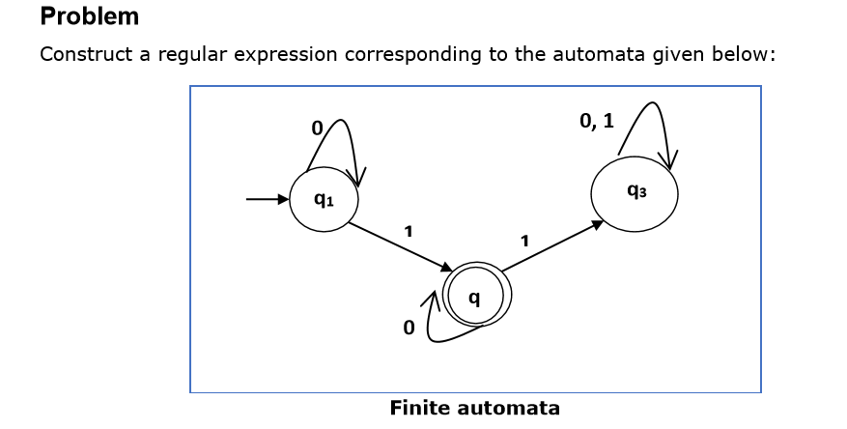

Slide 66
Solution:
Here the initial state is q1 and the final state is q2
Now we write down the equations:
q1 = q10 + є
q2 = q11 + q20
q3 = q21 + q30 + q31
Now, we will solve these three equations:
q1 = є0* [As, εR = R]
So, q1 = 0*
q2 = 0*1 + q20
So, q2 = 0*1(0)* [By Arden’s theorem]
Hence, the regular expression is 0*10*.

Slide 67
Pumping Lemma for Regular Languages
Theorem : Let L be a regular language. Then there exists a constant ‘c’ such that for every string w in L:
|w| ≥ c
We can break w into three strings, w = xyz, such that:
1. |y| > 0
2. |xy| ≤ c
3. For all k ≥ 0, the string xy^{k}z is also in L.
Applications of Pumping Lemma Pumping Lemma is to be applied to show that certain languages are not regular. It should never be used to show a language is regular.
If L is regular, it satisfies Pumping Lemma.
2. If L does not satisfy Pumping Lemma, it is non-regular.

Slide 68
Method to prove that a language L is not regular
1.At first, we have to assume that L is regular.
2. So, the pumping lemma should hold for L.
3. Use the pumping lemma to obtain a contradiction:
Select w such that |w| ≥ c
(b) Select y such that |y| ≥ 1
(c) Select x such that |xy| ≤ c
(d) Assign the remaining string to z.
(e) Select k such that the resulting string is not in L.
Hence L is not regular.

Slide 69
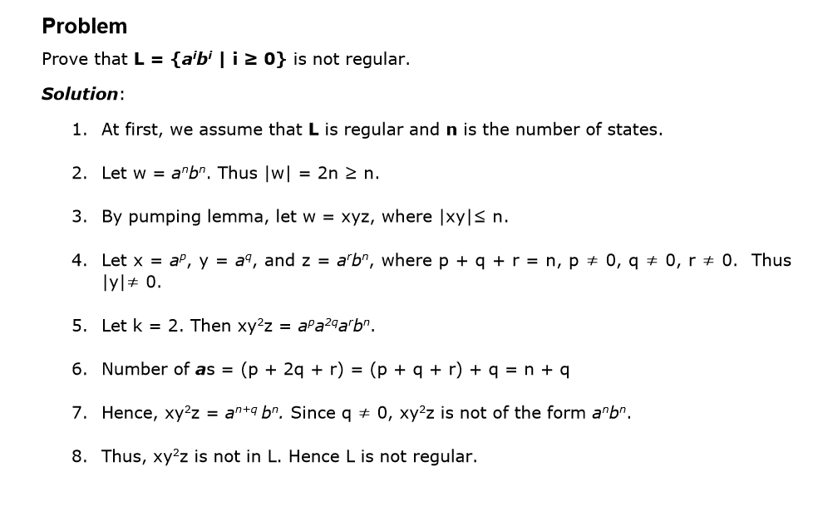

Slide 70
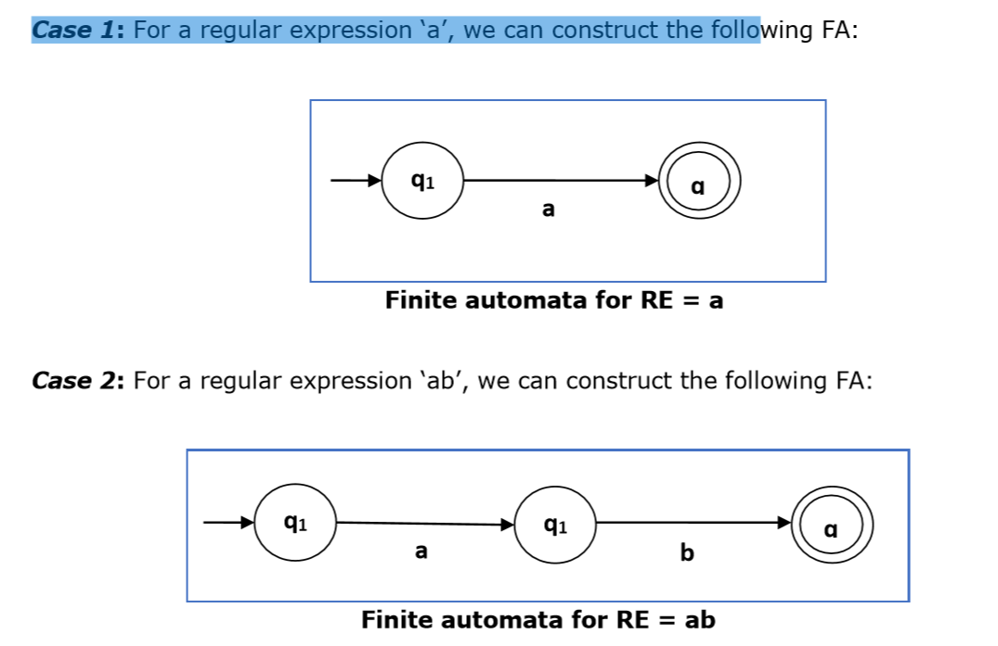
Construction of an FA from an RE
We can use Thompson's Construction to find out a Finite Automaton from a Regular Expression. We will reduce the regular expression into smallest regular expressions and converting these to NFA and finally to DFA.

Slide 71
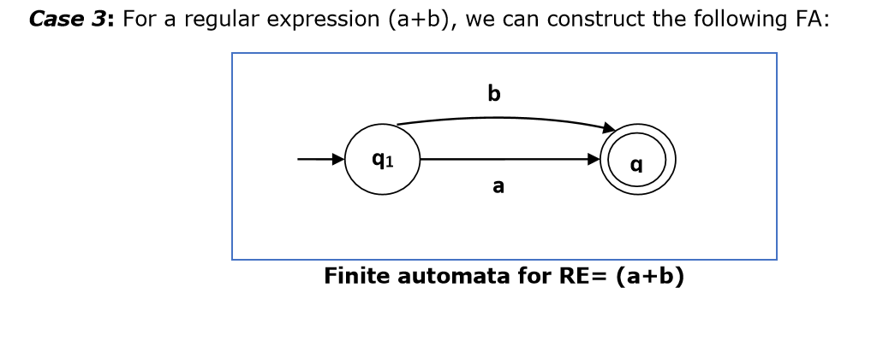
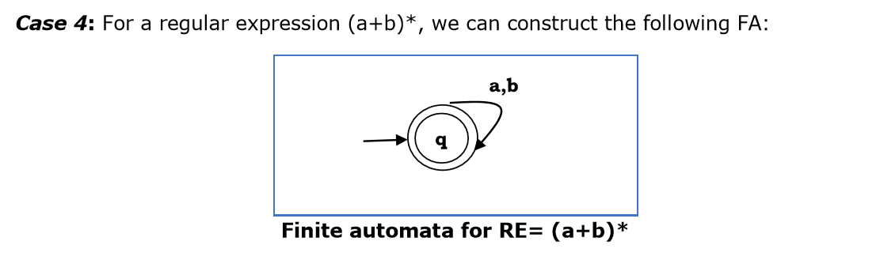

Slide 72
Method:
Step 1: Construct an NFA with Null moves from the given regular expression.
Step 2: Remove Null transition from the NFA and convert it into its equivalent DFA.
Problem Convert the following RA into its equivalent DFA: 1 (0 + 1)* 0

Slide 73
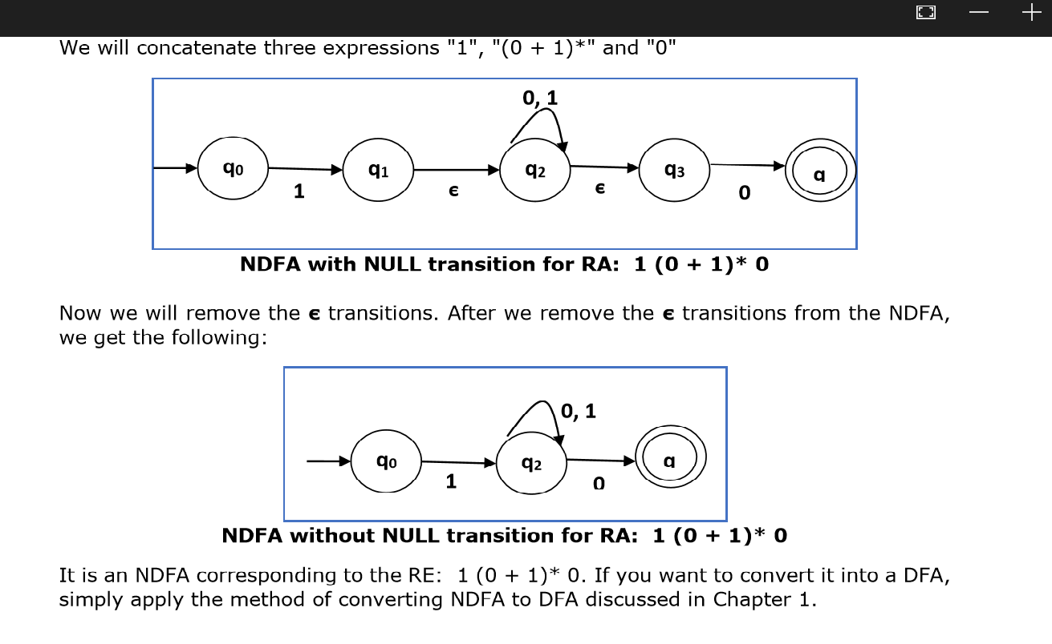

Slide 74
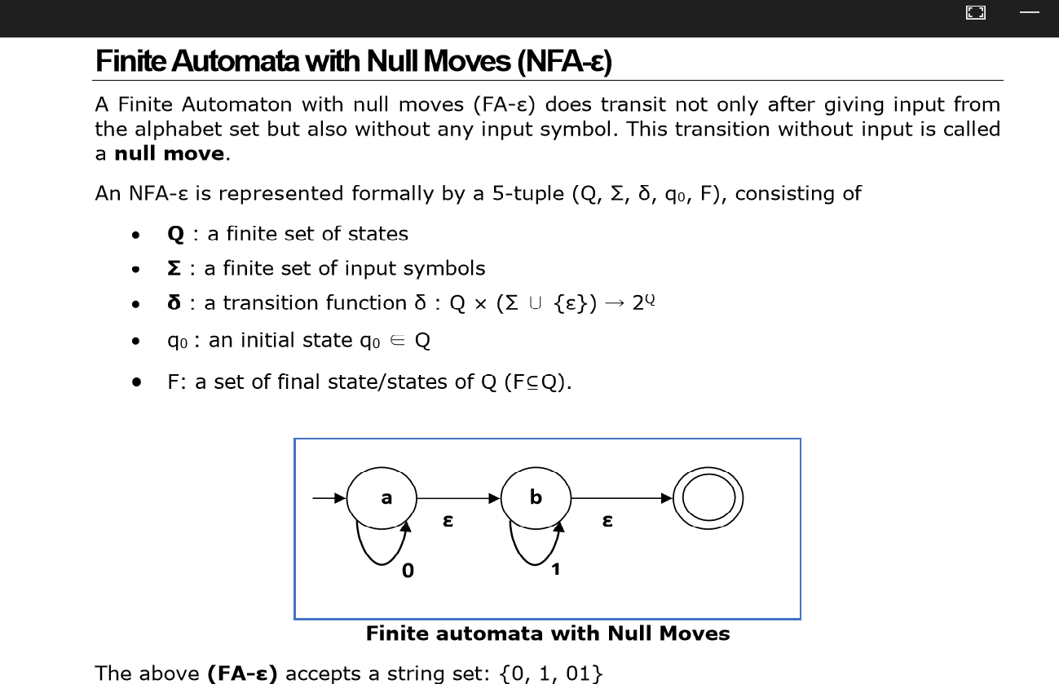

Slide 75
Removal of Null Moves from Finite Automata: If in an NDFA, there is ϵ-move between vertex X to vertex Y, we can remove it using the following steps:
Find all the outgoing edges from Y.
Copy all these edges starting from X without changing the edge labels.
If X is an initial state, make Y also an initial state.
4. If Y is a final state, make X also a final state.

Slide 76
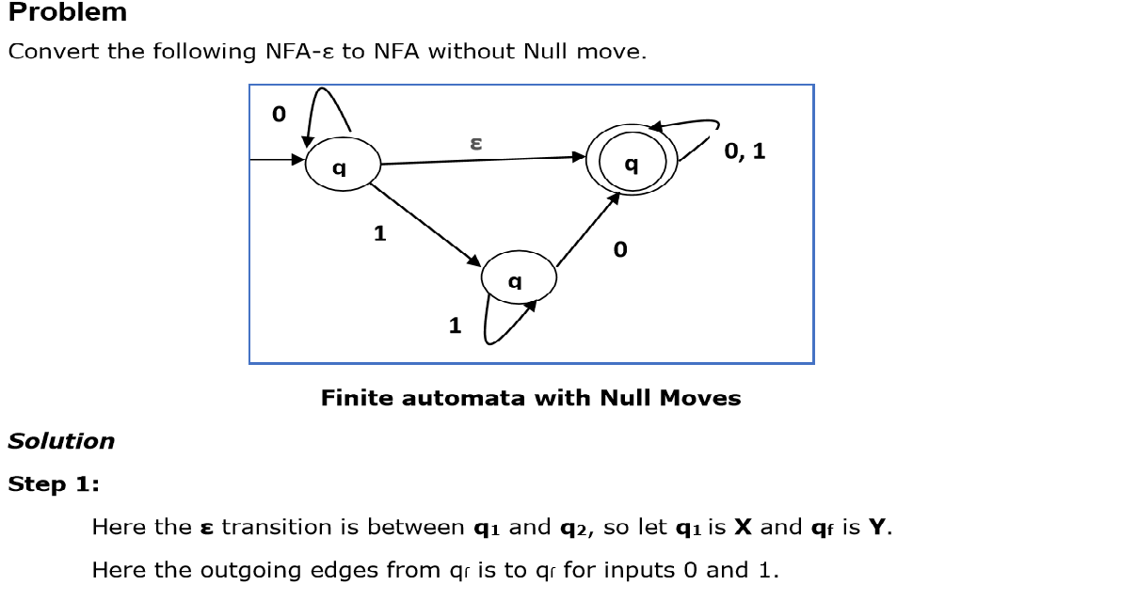

Slide 77
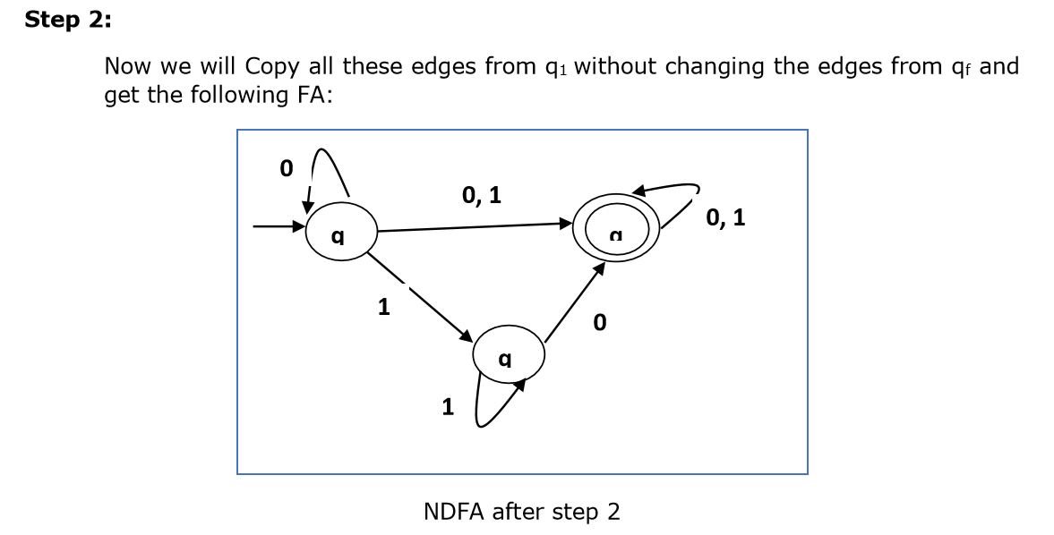
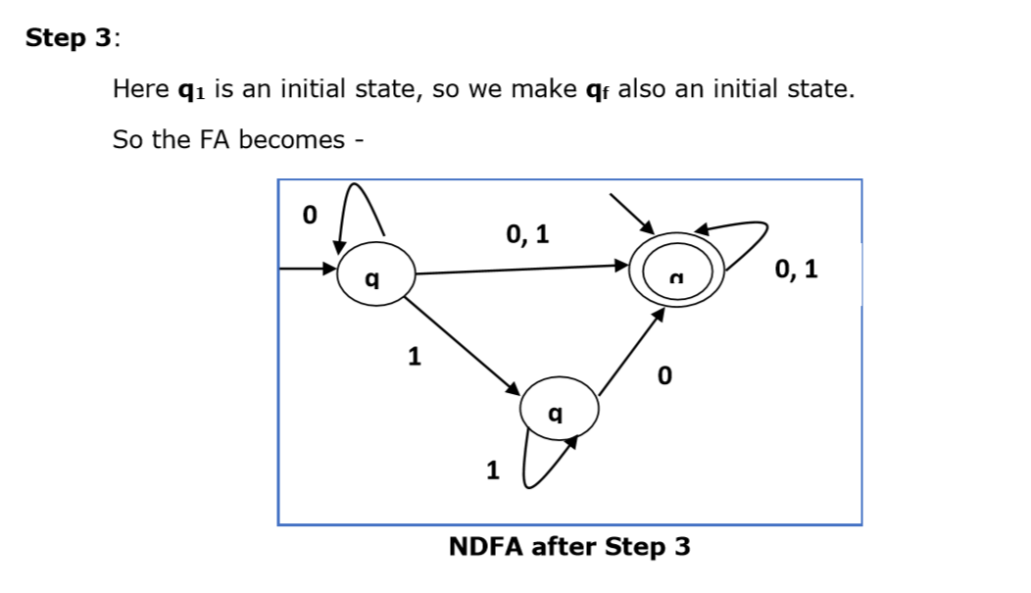

Slide 78
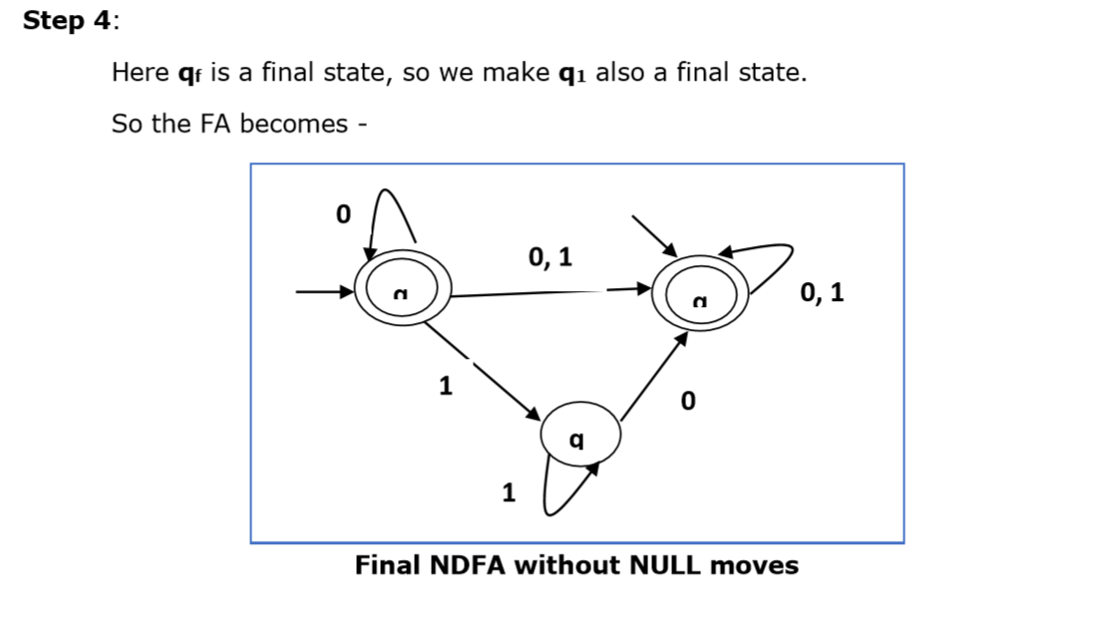

Slide 79
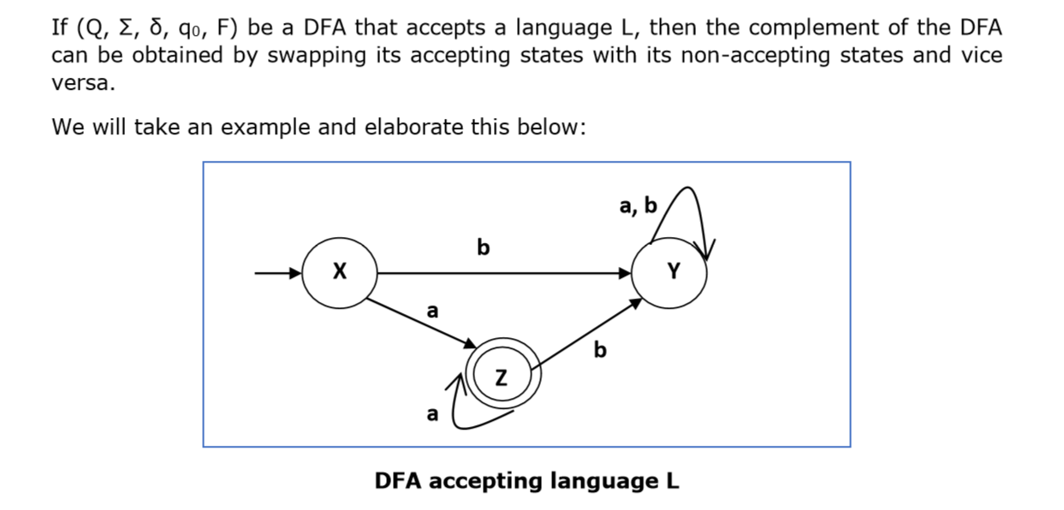
DFA Complement

Slide 80
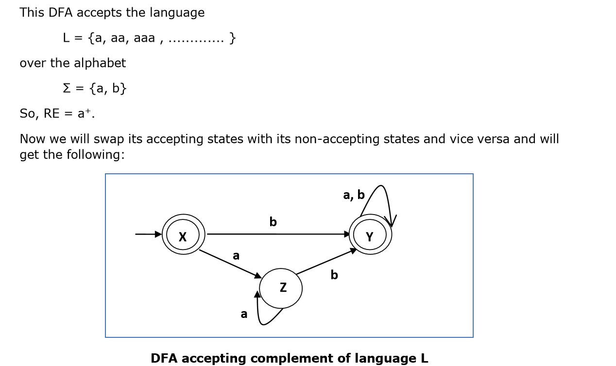

Slide 81
This DFA accepts the language
Ľ = {ε, b, ab ,bb,ba, ............... } over the alphabet
Σ = {a, b}
Note: If we want to complement an NFA, we have to first convert it to DFA and then have to swap states as in the previous method.

Slide 82
Context-Free Grammar Introduction
Definition: A context-free grammar (CFG) consisting of a finite set of grammar rules is a quadruple (N, T, P, S) where
N is a set of non-terminal symbols.
T is a set of terminals where N ∩ T = NULL.
P is a set of rules, P: N → (N U T)*, i.e., the left-hand side of the production rule P does have any right context or left context.
S is the start symbol.
Example :
The grammar ({A}, {a, b, c}, P, A), P : A → aA, A → abc.
The grammar ({S, a, b}, {a, b}, P, S), P: S → aSa, S → bSb, S → ε The grammar ({S, F}, {0, 1}, P, S), P: S → 00S | 11F, F → 00F | ε

Slide 83


Slide 84


Slide 85


Slide 86


Slide 87


Slide 88


Slide 89

2)The rightmost derivation for the above string "a+a*a" may be:
X → X*X→ X*a → X+X*a →X+a*a→ a+a*a

Slide 90


Slide 91

Left and Right Recursive Grammars :In a context-free grammar G, if there is a production in the form X → Xa where X is a non-terminal and ‘a’ is a string of terminals, it is called a left recursive production. The grammar having a left recursive production is called a left recursive grammar.
And if in a context-free grammar G, if there is a production is in the form X → aX where X is a non-terminal and ‘a’ is a string of terminals, it is called a right recursive production. The grammar having a right recursive production is called a right recursive grammar.

